Slide 1



Self-certification of e-BRC
on DGFT e-platform

Slide 2
INTRODUCTION
Electronic - Bank Realization Certificate (e-BRC) is an important document that establishes the details of inward forex remittance to avail various benefits under the Foreign Trade Policy and other tax exemptions and refunds under the GST provisions. It acts as a confirmation payment realized against exports made.
Owing to the importance of e-BRC and with an aim to make this process efficient and reduce compliance costs and burden for the exporters, the Directorate General of Foreign Trade has taken the initiative to allow generation of e-BRCs by exporters on a self-certification basis by visiting the DGFT website (www.dgft.gov.in).

Slide 3
Advantages of revamped e-BRC process
  To Exporters will be able to generate the e-BRCs based on self declaration by providing only meta data of the shipping bills, Softex, or Invoices. No hardcopies will be needed.
  Exporters do not have to pay e-BRC charges to the banks or visit them in person.
  Digital exchange of e-BRC generated with other regulatory agencies such as RBI, CBDT, GSTN, STPI, SEZs etc. for utilisation and post issue verification/audit is envisioned. Exporters do not have to submit hard copies of export related documents to the RBI, STPI/ SEZs units, or to the banks.
  Unburdening of banks from routine issuance of eBRCs.
  Banks to move towards post issuance audit based verification mechanism via self-devised Risk Management System.

Slide 4
General guidelines for generating eBRC:
  Multiple IRM’s can be added.
  IRM of same currency can only be clubbed.
  User cannot generate eBRC for P0101 and P0108 (Purpose Code not in P0101 and P0108)
  To generate the eBRC for purpose code P0103 for stand-alone or with clubbed, shipping bill date/Invoice should be greater than or equal to the remittance date. No ebrc generation to be allowed before the shipping bill/invoice date even for advance payment.
  P0103 can be used standalone to generate eBRC.
P0103 can be clubbed with P0807 in case of Services > IT.
P0103 can be clubbed with any of the 01 Product Groups except P0101 and P0108. (Purpose code list at the end of the help manual)
P0103 can be clubbed with P1505 to generate eBRC.
  No two purpose codes will be allowed to be clubbed to generate the single eBRC Except P0103
(Advance payment) which can be clubbed with any other purpose codes for inward remittance.
  For Services > IT, only these three purpose codes are applicable - P0802, P0803, P0807 and P0103.
  One Shipping bill can be utilised for two or more eBRC of different banks.
  IRM of the same bank name and Bank account number can only be clubbed.
In the case of Service Exports, Exporters will be able to view and attach invoices that have SAC codes matching the description of the same services only.

Slide 5
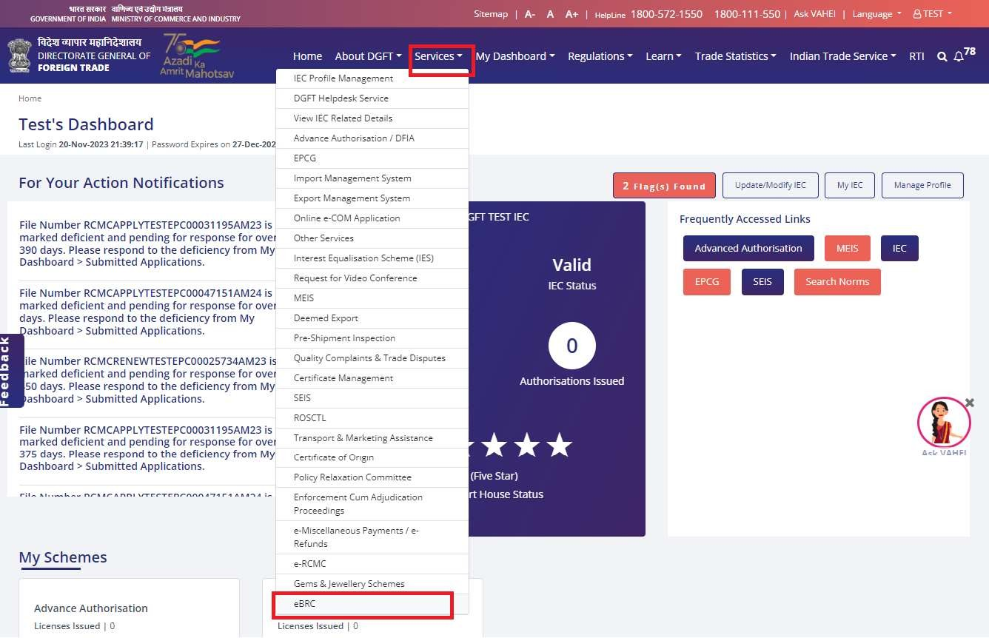
To View IRM/ORM uploaded by Bank, exporter will go to below mentioned path in DGFT website:
Visit the DGFT website https://www.dgft.gov.in/CP and login into the portal using valid credentials.
Post logins go to the Services> Select eBRC> Click on IRM/ORM repository. Exporter will be redirected to View IRM/ORM screen.
View and Bulk Download IRM / ORM

Slide 6
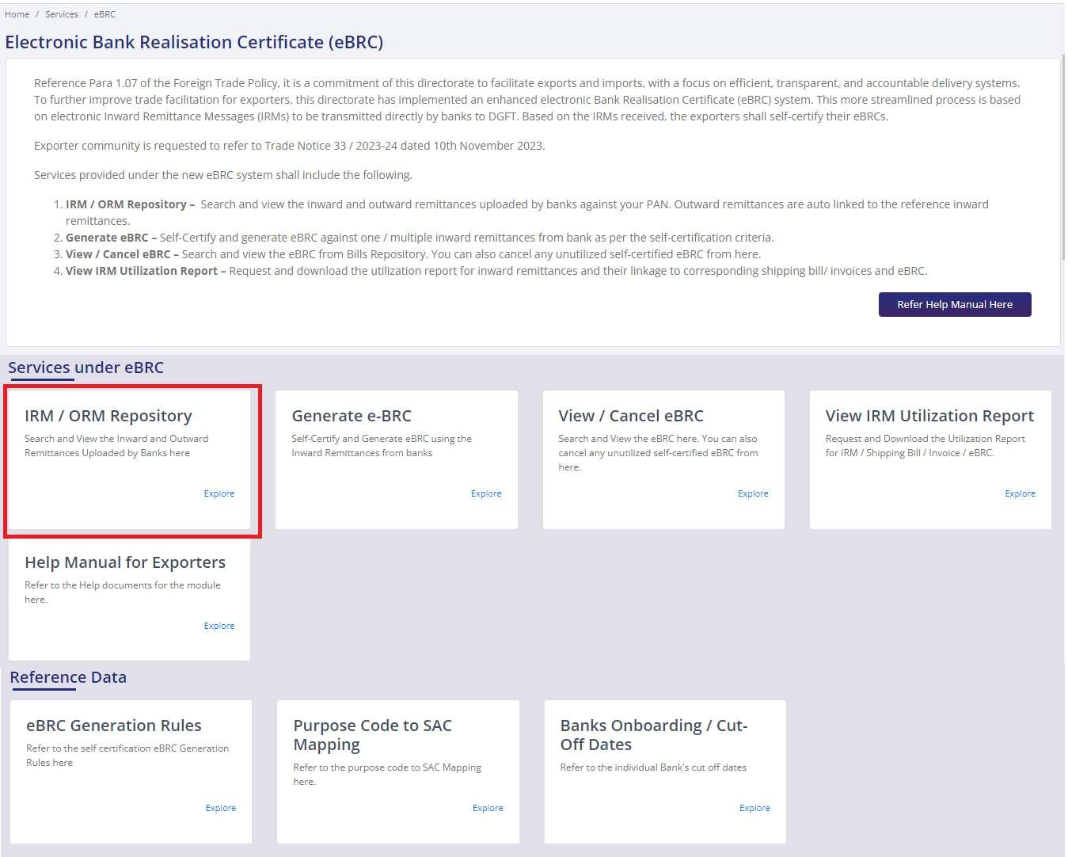

Slide 7
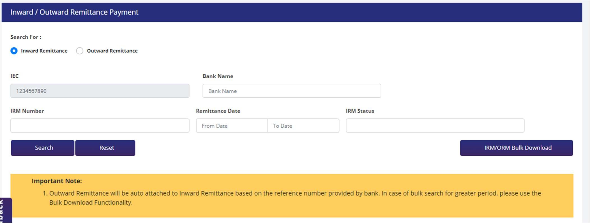
In view screen both search options are available, For Inward Remittance or for Outward Remittance. Exporter can select either one among them. IEC number will auto populate.
Exporters need to enter IRM number, bank name, or any of the filter options provided and click on search.
List will populate on the screen with complete details related to IRM/ ORM number.
For Bulk Download of IRMs/ORMs available against particular IEC, parameters as above can be selected and the button in bottom right-side corner labelled “Request Bulk Download IRM/ORM maybe clicked for download of file.

Slide 8
Generate e-BRC from IRM
  User will register on the DGFT website as Importer / Exporter. If they are not already registered. Instructions for new registrations can be found here - https://content.dgft.gov.in/Website/DGFT- Website_User_Registration.pdf
  User will link their existing IEC (Instructions: https://content.dgft.gov.in/Website/DGFT-Website- Link_your_IEC.pdf) or apply for new IEC.
  Once the user is available with IEC on DGFT Website, user will proceed with navigating to
Services>eBRC> Generate e-BRC.

Slide 9
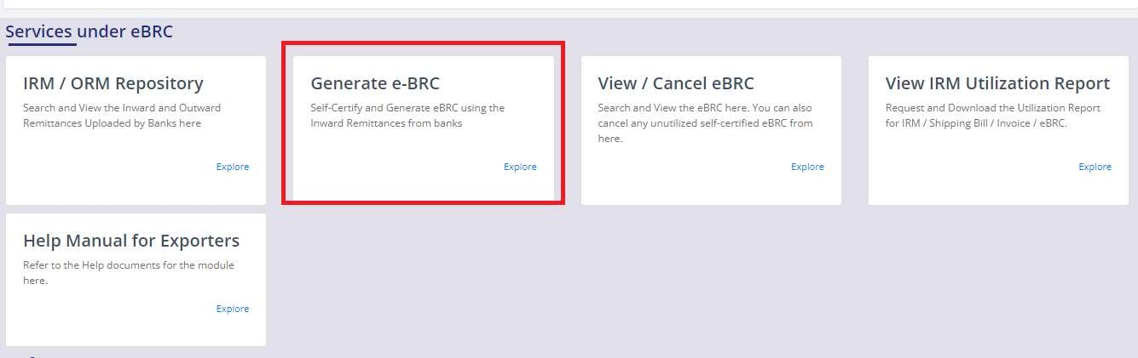
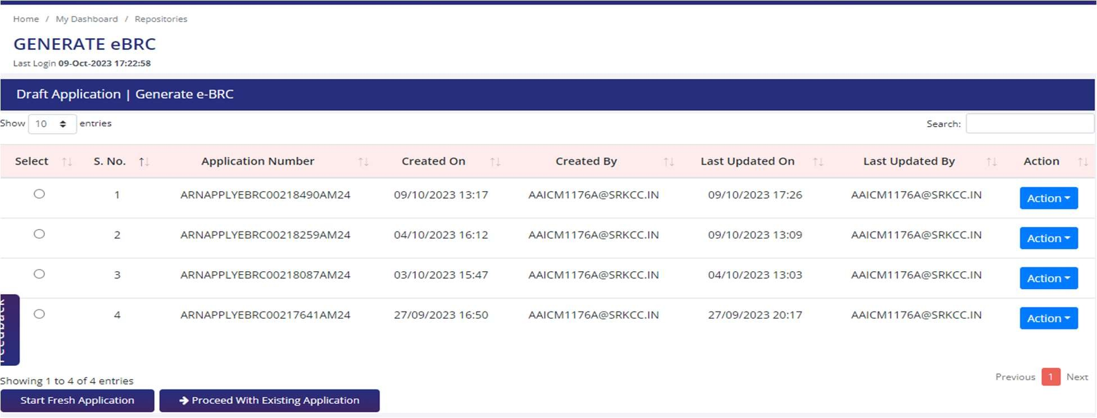
4) The following landing page will be displayed.
The e-BRC landing page will only be available after a user completes login on DGFT website.
On click of the Generate e-BRC tile, the user will be navigated to the common draft list screen for the e-BRC form (post login).

Slide 10
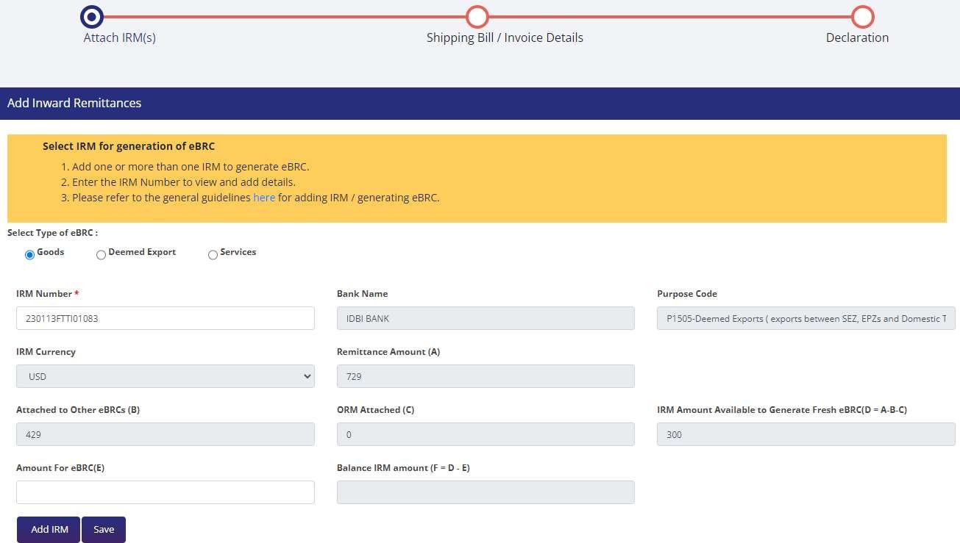
7) Exporter can select type of e-BRC as For physical export of Goods / For Deemed exports of Goods orFor export of Services (Under services exporter will select the type of category as IT or NON-IT).
.

Slide 11
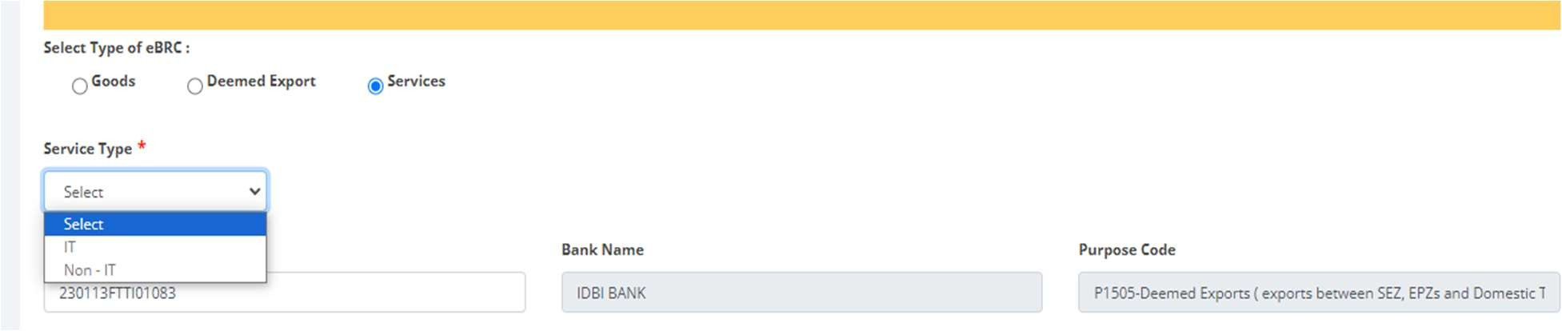
The exporter will enter the IRM number in the form &Amount for eBRC (E) only and the rest of data will auto be populated. The following fields will be auto populated-
Bank Name
Purpose code
IRM currency
Remittance amount (A)
Attached to the other eBRC (B)
ORM attached (C)
IRM amount available to Generate fresh eBRC (D)
Balance IRM amount
Note: Balance IRM amount will be calculated F = A – B – C – E and IRM amount available to Generate fresh eBRC will be calculated D = A – B – C.

Slide 12
8) Rules for clubbing of IRM-
Multiple IRM’s can be added.
IRM of same currency can only be clubbed.
User cannot generate eBRC for P0101 and P0108 (Purpose Code not in P0101 and P0108)
To generate the eBRC for purpose code P0103 for stand-alone or with clubbed, shipping bill date/Invoice should be greater than or equal to the remittance date. No ebrc generation to be allowed before the shipping bill/invoice date even for advance payment.
P0103 can be used standalone to generate eBRC.
P0103 can be clubbed with P0807 in case of Services > IT.
P0103 can be clubbed with any of the 01 Product Groups except P0101 and P0108. (Purpose code list at the end of the help manual)
P0103 can be clubbed with P1505 to generate eBRC.
No two purpose codes will be allowed to be clubbed to generate the single eBRC Except P0103
(Advance payment) which can be clubbed with any other purpose codes for inward remittance.
For Services > IT, only these three purpose codes are applicable - P0802, P0803, P0807 and P0103.
One Shipping bill can be utilised for two or more eBRC of different banks.
IRM of the same bank name and Bank account number can only be clubbed.
In the case of Service Exports, Exporters will be able to view and attach invoices that have SAC codes matching the description of the same services only.

Slide 13
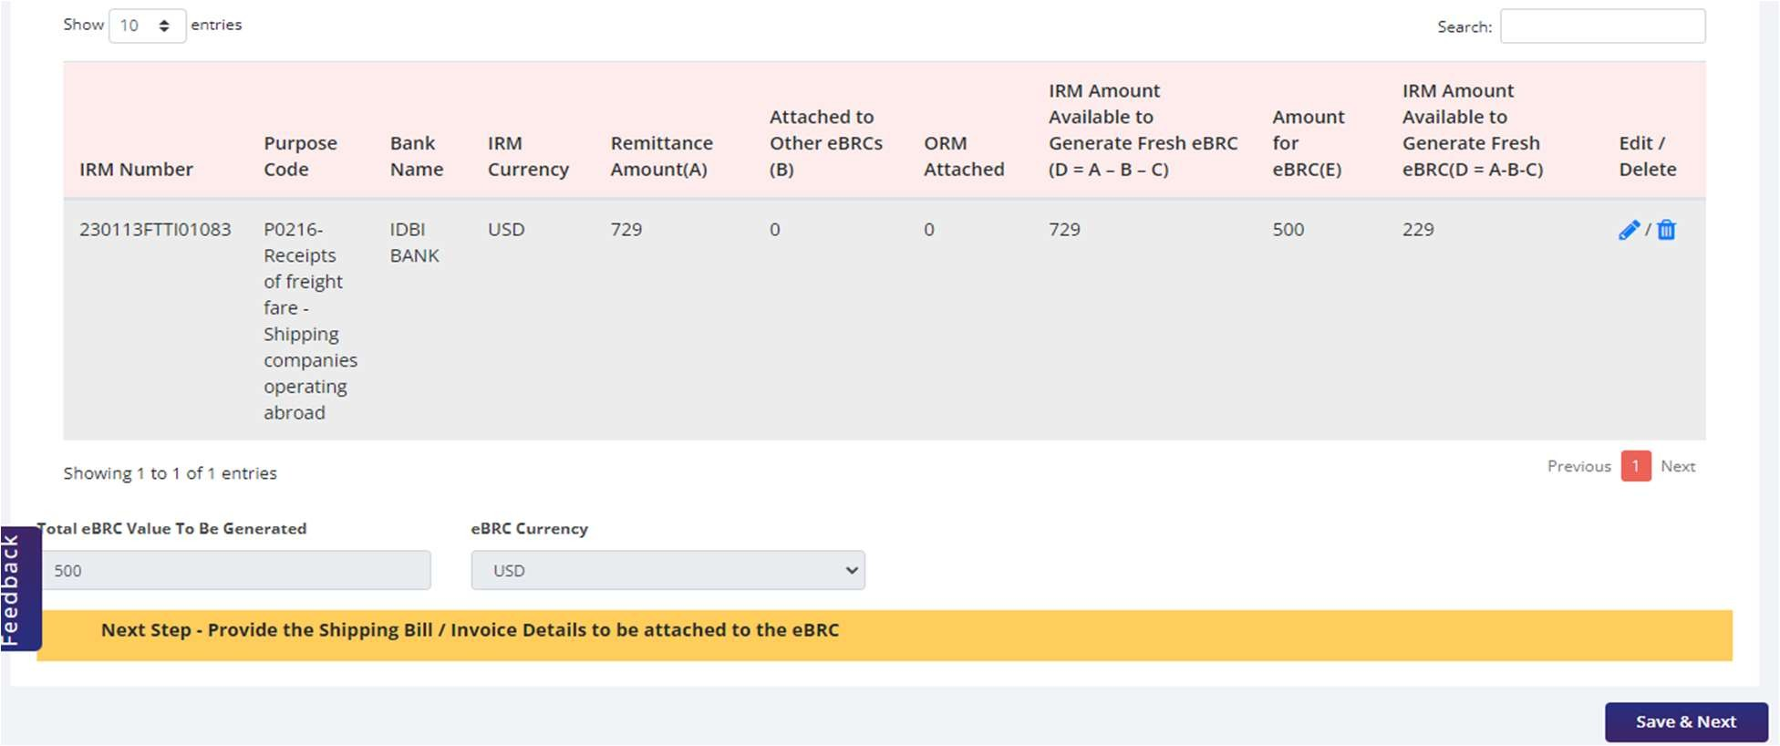
9) After adding the IRM’s in the table total amount will be calculated.

Slide 14
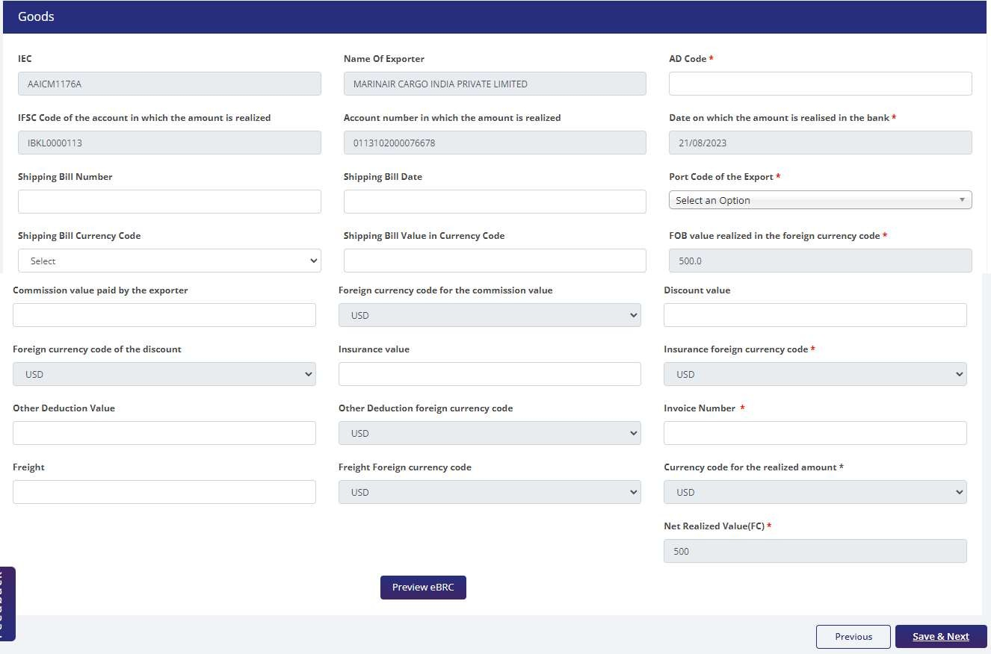
10) After clicking on Save & Next button eBRC details page will be shown-
For GOODS-

Slide 15
IEC- This field will be auto-populated.
Name of the Exporter- This field will be auto-populated.
AD Code (Mandatory field) - Exporter will enter the AD code.
IFSC Code of the account in which amount is realised- This field will be auto-populated.
Account number in which amount is realised- This field will be auto-populated.
Date on which amount is realised- The latest date from the clubbed IRM’s will be auto- populated.
Shipping Bill number (Mandatory field)- Exporter will enter the SB number.
Shipping Bill date (Mandatory field)- Exporter will enter the date
Port code of the export (Mandatory field)- Smart search will be enabled and the exporter enter the port code.
Shipping bill currency code (Mandatory field)- Exporter select the currency from drop-down option.
Shipping value in currency code (Mandatory field)- Exporter will enter the value.
FOB value realised in the foreign currency – The total sum of IRM amount clubbed will be auto-populated in this field.
Commission Value - Exporter will enter the value.
Foreign currency code for the commission value- This field will be auto-populated.
Discount value- Exporter will enter the value.
Foreign currency code of the discount- This field will be auto-populated.
Insurance value- Exporter will enter the value.
Insurance foreign currency code- This field will be auto-populated.

Slide 16
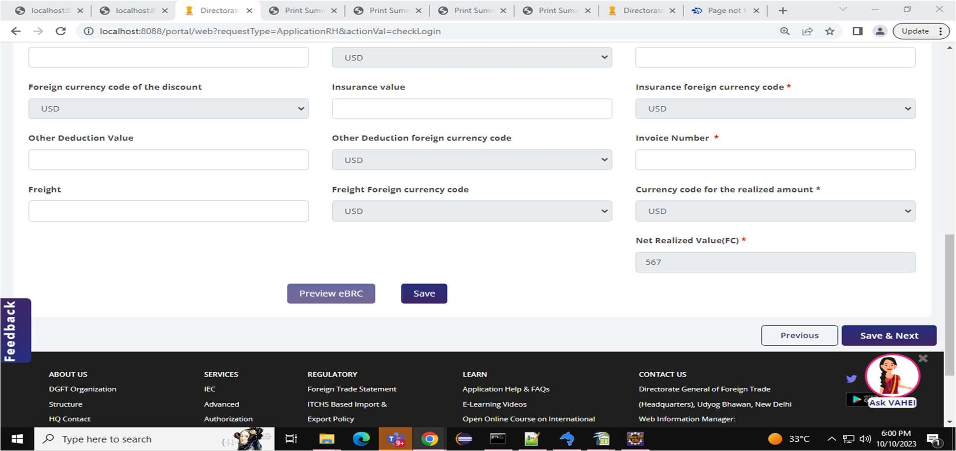
Other Deduction Value- Exporter will enter the value.
Other Deduction foreign currency code- This field will be auto-populated.
Invoice Number (Mandatory field)- Exporter will enter the invoice number.
Freight- Exporter will enter the value.
Freight Foreign currency code- This field will be auto-populated.
Currency code for the realized amount- IRM currency will be auto-populated in this field.
Net Realized Value (FC) – This field will be auto-calculated.
Net Realised (FC) = FOB value realised in the foreign currency - Commission Value - Discount value
Insurance value - Other Deduction Value – Freight
11) After entering the data user will click on save button and will be able to preview the e-BRC

Slide 17
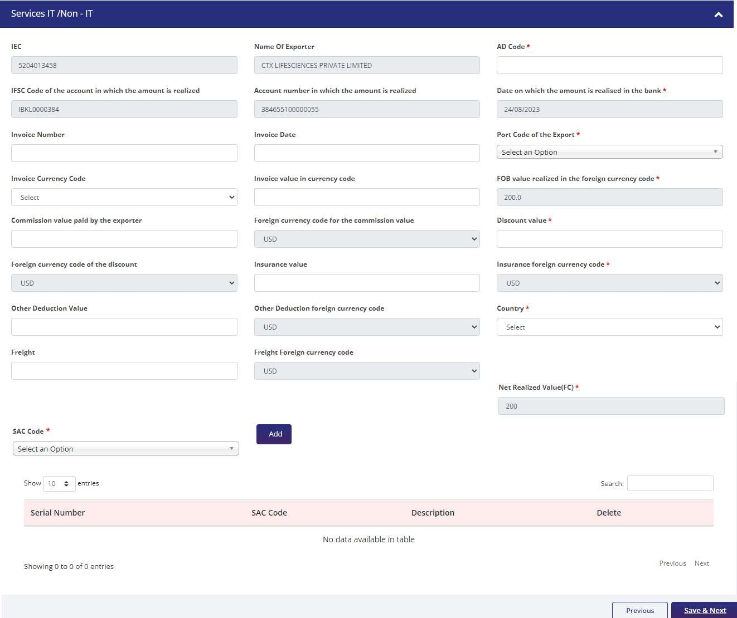
For Services (IT & Non-IT)-

Slide 18
IEC- This field will be auto-populated.
Name of the Exporter- This field will be auto-populated.
AD Code (Mandatory field) - Exporter will enter the AD code.
IFSC Code of the account in which amount is realised- This field will be auto-populated.
Account number in which amount is realised- This field will be auto-populated.
Date on which amount is realised- The latest date from the clubbed IRM’s will be auto- populated.
Invoice number (Mandatory field)- Exporter will enter the invoice number.
Invoice date (Mandatory field)- Exporter will enter the date
Port code of the export (Mandatory field)- Smart search will be enabled and the exporter enter the port code.
Invoice currency code (Mandatory field)- Exporter select the currency from drop-down option.
Invoice value in currency code (Mandatory field)- Exporter will enter the value.
FOB value realised in the foreign currency – The total sum of IRM amount clubbed will be auto-populated in this field.
Commission Value - Exporter will enter the value.
Foreign currency code for the commission value- This field will be auto-populated.
Discount value- Exporter will enter the value.
Foreign currency code of the discount- This field will be auto-populated.
Insurance value- Exporter will enter the value.
Insurance foreign currency code- This field will be auto-populated.
Other Deduction Value- Exporter will enter the value.
Other Deduction foreign currency code- This field will be auto-populated.
Freight- Exporter will enter the value.
Freight Foreign currency code- This field will be auto-populated.

Slide 19

Currency code for the realized amount- IRM currency will be auto-populated in this field.
SAC Code-Smart search will be enabled and the exporter can search and the SAC code. For Softex & services SAC codes will be different refer Annexure D – Master Data – Purpose Code Mapping to SAC Code.
Net Realised (FC) = FOB value realised in the foreign currency - Commission Value - Discount value
- Insurance value - Other Deduction Value – Freight
12) After entering the data user will click on save button and will be able to preview the e-BRC

Slide 20
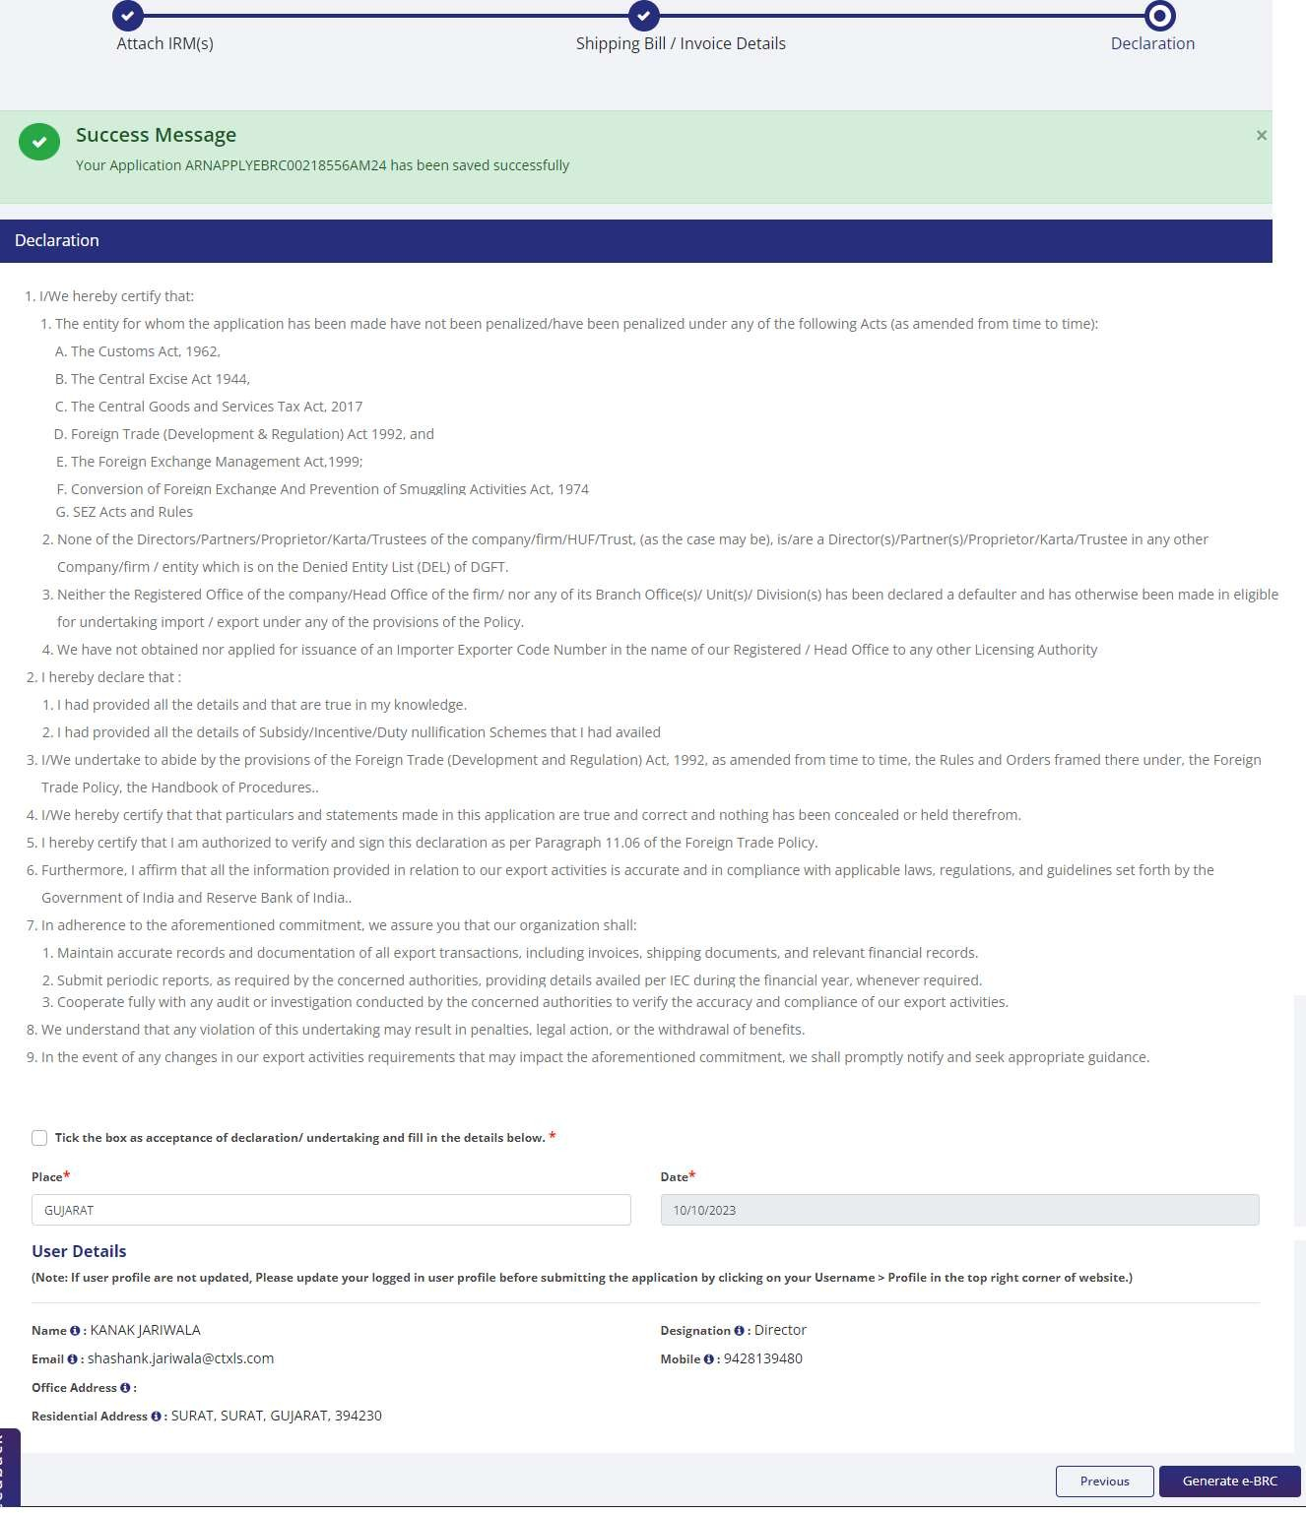
13) After clicking on Save & Next button exporter will read the declaration and tick the check box.

Slide 21
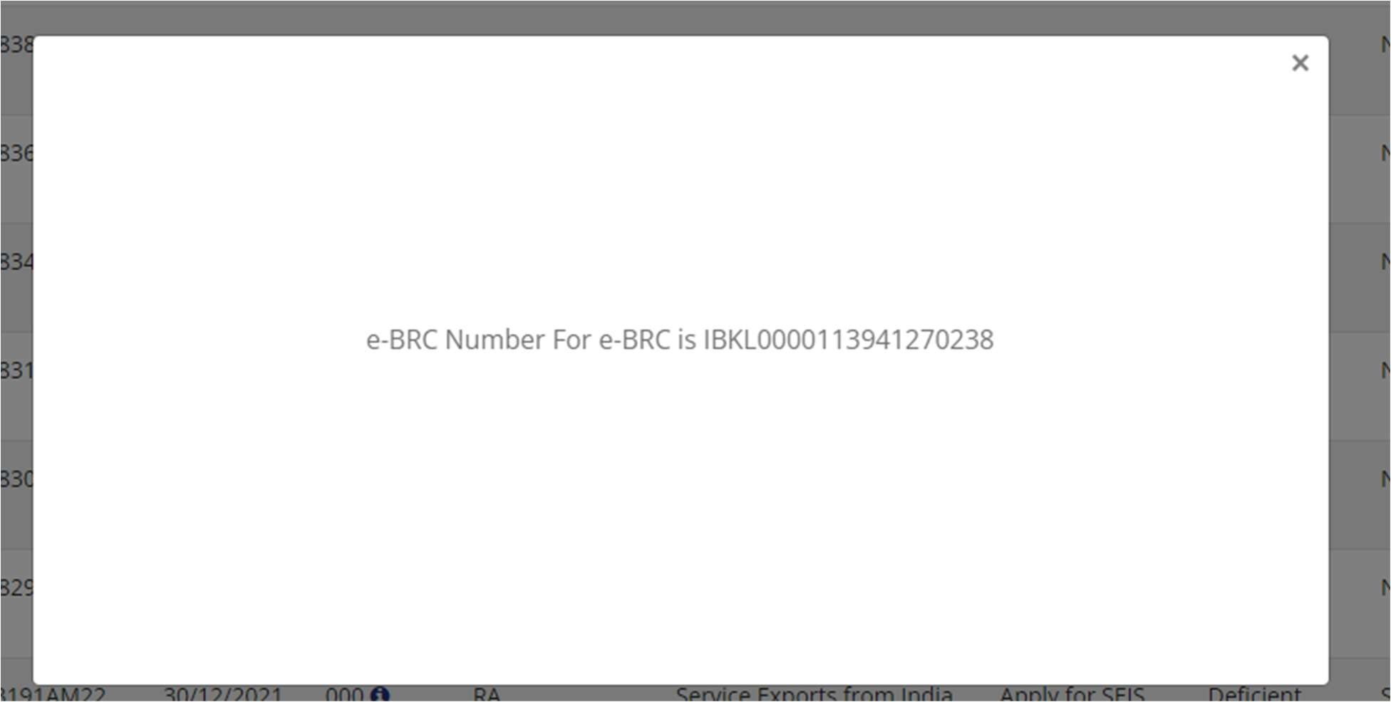
14) On submitting the form by clicking on the Generate e-BRC button the e-BRC will be generated and same will be visible in respected Banks &RA offices in Repository under Loaded status. A prompt message will appear stating the e-BRC Number.

Slide 22
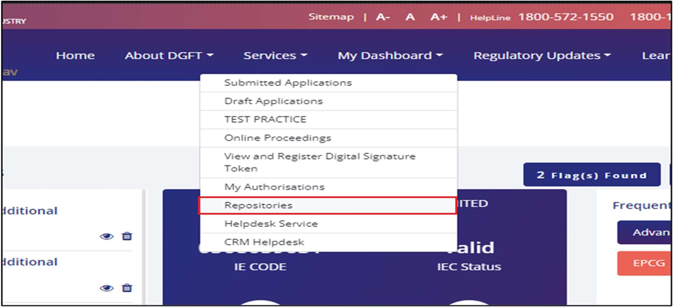
Cancelling e-BRC
Following will be the workflow to Cancel the eBRC.
  Navigate to My Dashboard > Repository > Bill Repositories > Select e-BRC from the dropdown > Search the e-BRC using the appropriate filters.

Slide 23
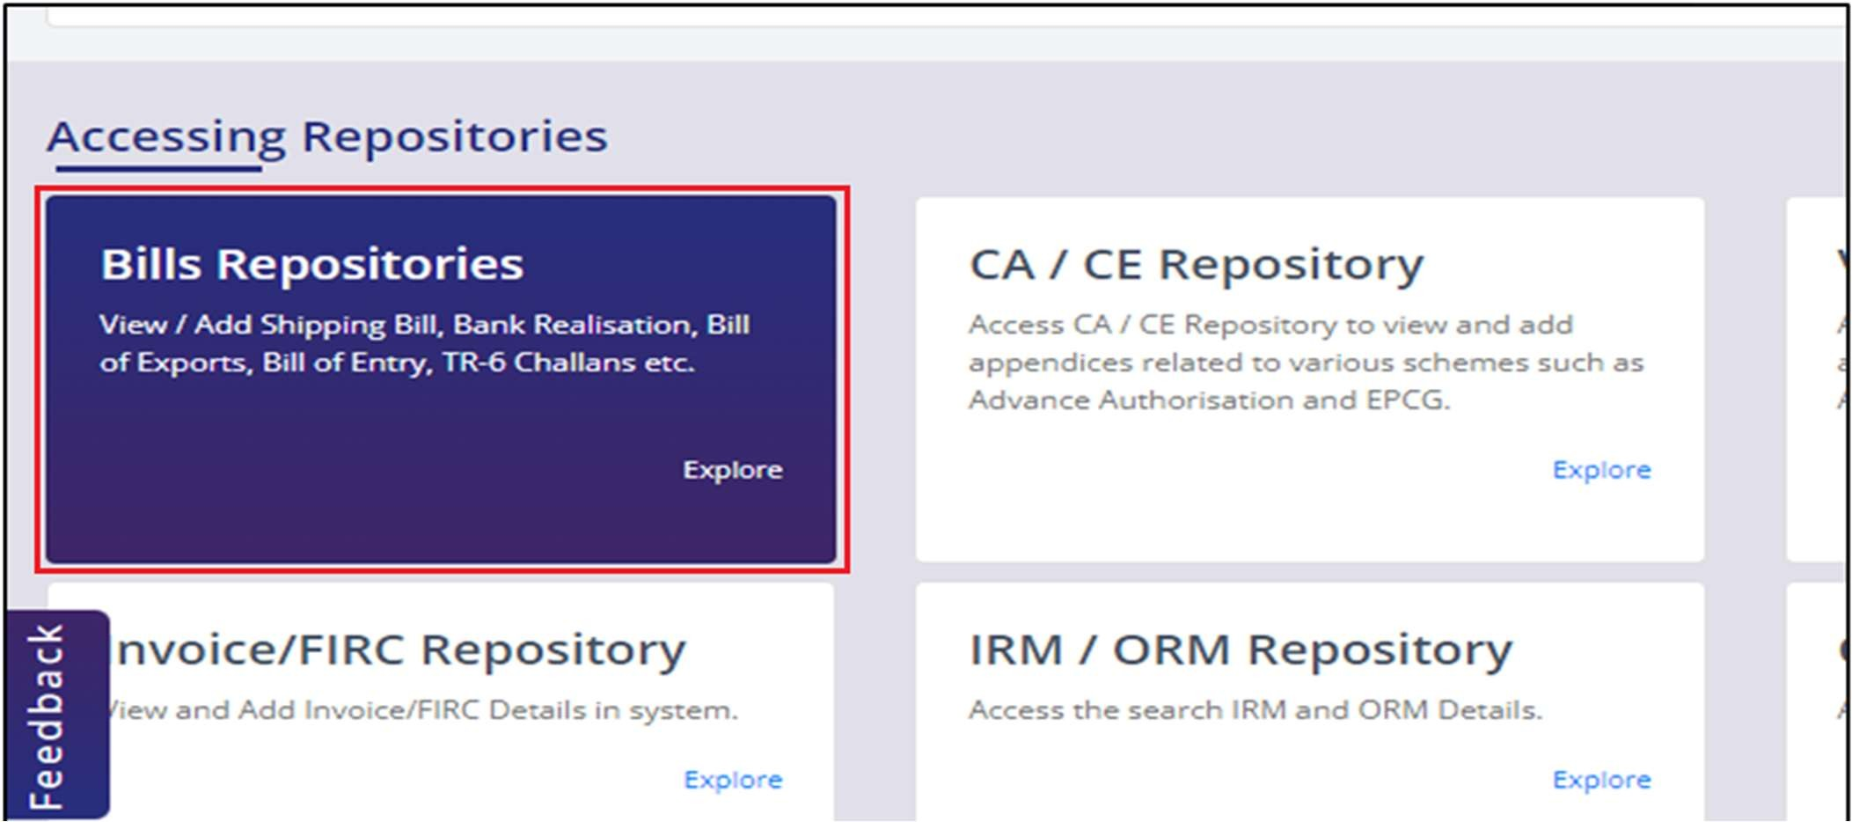
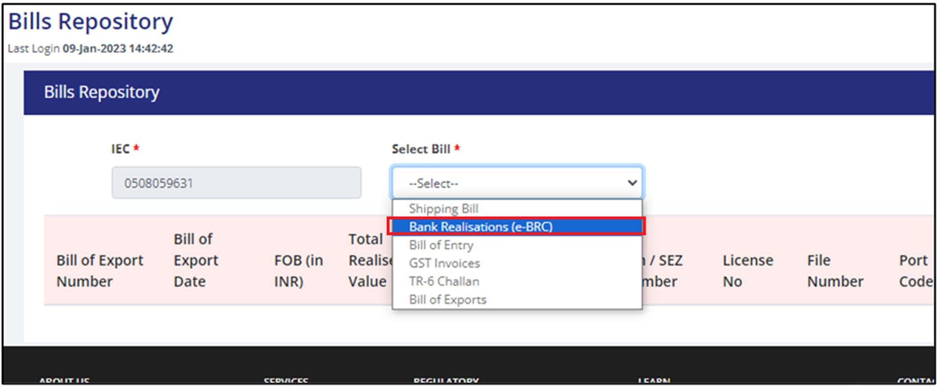
----------------------------------------------------------------------------------------------------------------------

Slide 24
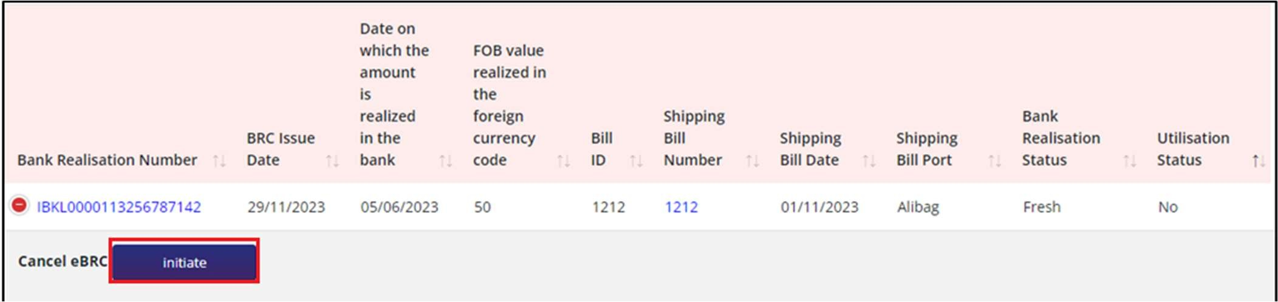
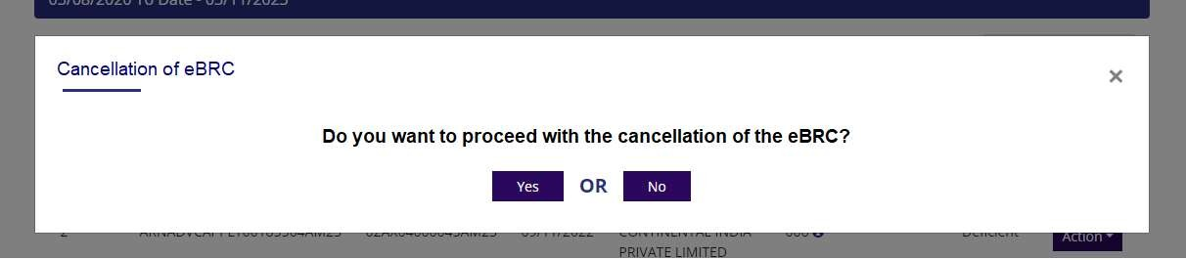
2. After searching the e-BRC, from the cancel e-BRC column click on Initiate button.
Note: (a) Initiate button will be enabled for the eBRC’s which were generated by the exporter from
the DGFT portal.
(b) Cancellation of the eBRC will not be allowed if it is ultilised in the application.
3. Pop-up will appear asking for confirmation of cancellation. On click of yes the page will be directed to the eBRC cancellation form.

Slide 25
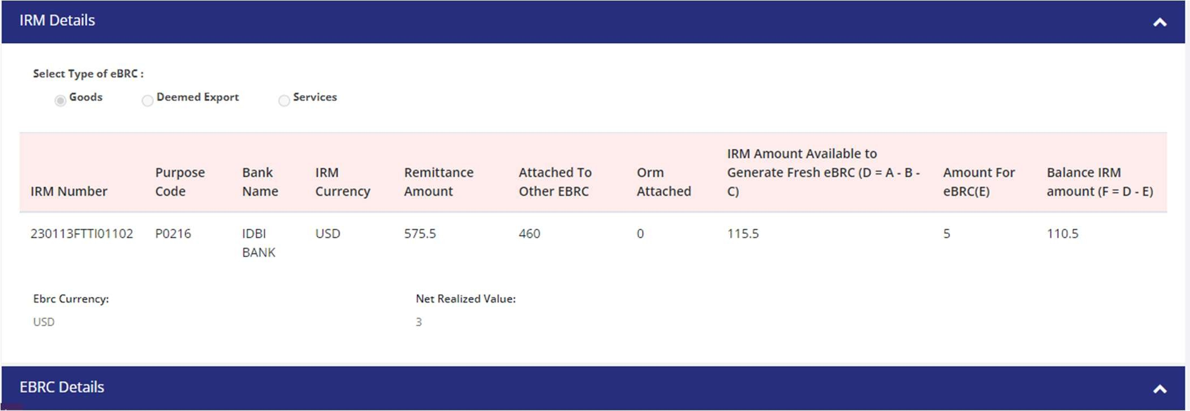
4. Details of IRM i.e., IRM grid and type of eBRC which was in the generate eBRC flow will be shown to the exporter in view only mode. At the bottom of the page, a remarks box (character limit of 250) will be provided for the exporter which will be mandatory.

Slide 26
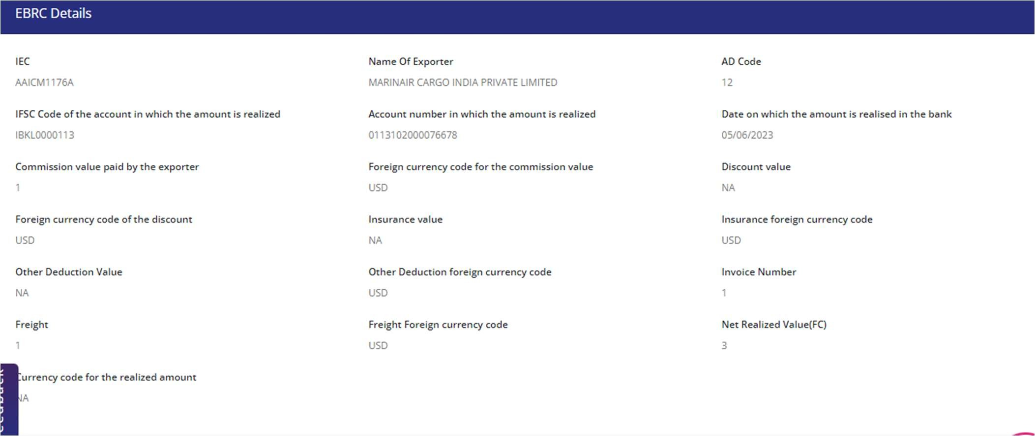

Slide 27
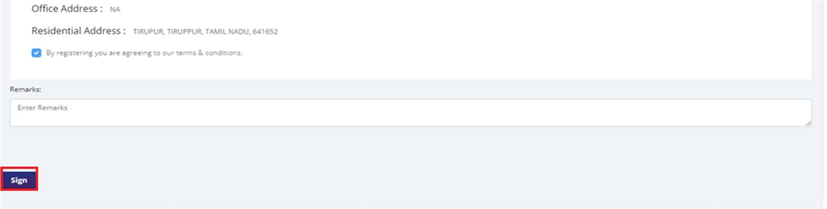
5. Exporter will tick the declaration and DSC / e-Sign for the submission of the application.
Note: -
The e-BRC which are uploaded by the banks cannot be cancelled.
Only those e-BRCs generated by exporter on self-certification basis from the DGFT portal can be cancelled by the exporters provided the same has not been utilised for claiming any benefits/incentives/IGST or other refunds/remission/credits.

Slide 28
IRM Utilisation Report
This report can help the exporters to analyse the IRM activity.
  Post logins go to the Services>Select eBRC > Click on View IRM Utilization Report. Exporter will be redirected to IRM Utilization Report screen.

Slide 29
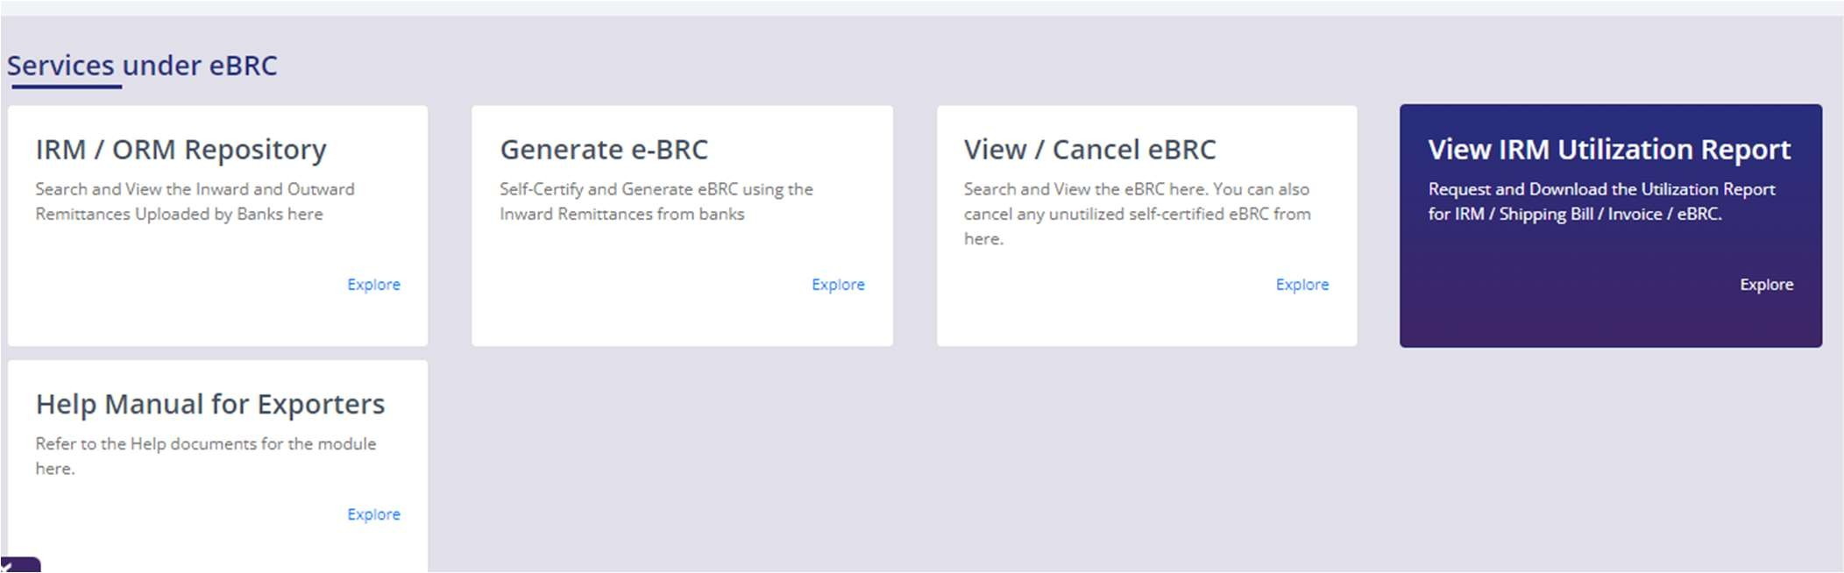
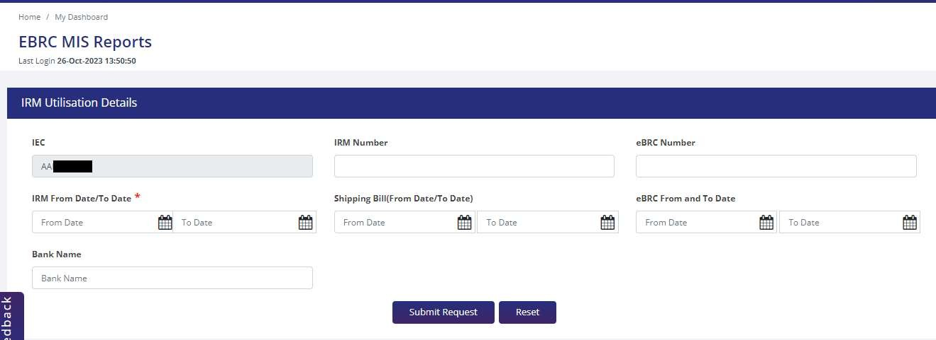
3. Exporter can generate report according to the filters given on the screen.

Slide 30
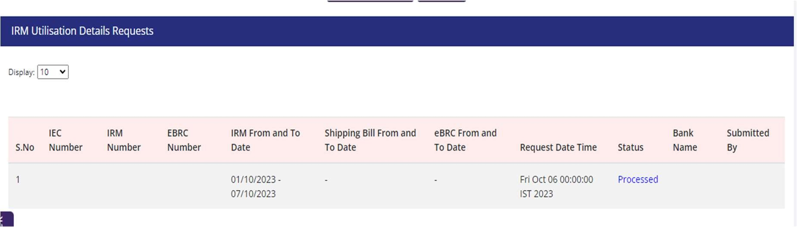
4. After entering the suitable parameters the request will be created and will be shown in the table below.
User will submit request for processing
Batch will pick up request and generate report to send over email
Status - Submitted / Processed / Failed.
Status will be clickable to download the excel report too for processed
Failed - will show the error why failed (Too many records etc.)

Slide 31









THANK YOU!

